Slide 1
DSO 552 SQL Databases for Business Analysts
Instructor: Yu Chen
TA: Shubham Rishishwar
Fall 2020

Slide 2

What is a Database?
A database is a collection of information that is organized so that a business can access, manage, and update it.
The most common type of database is a relational one; this is a database that is structured to recognize relations among data items as a set of formally-described tables. (DSO 522 focuses on relational databases)

Slide 3
What is SQL?
SQL is a standard language for querying and manipulating data
SQL stands for Structured Query Language
Data Definition Language (DDL)
Define relational schema
Create/alter/delete tables and their attributes
Data Manipulation Language (DML)
Insert/delete/modify tuples in tables
Query one or more tables – discussed next!

Slide 4
Let’s get started with SQL
Open pgAdmin 4.
Connect to the class database server:
Host: database.ychennay.com
User: dso-student-ro
Database: parch_and_posey_example
PW: (see Slack Channel)

Slide 5
Parch & Posey Database
Parch & Posey is a fabricated non-real company that sells paper.
There are 50 sales reps spread across the United States in 4 regions.
There are 3 types of paper. Regular, Poster and Glossy.
The clients are primarily large Fortune's 100 companies whom are attracted by Google, Facebook and Twitter.
Questions answered using Parch & Posey data are meant to simulate real word problems. Using SQL, we will help Parch & Posey answer tricky questions like:
Which of their product lines is worst performing?
Which of their market channels they should make a great investment in.
In the Parch & Posey database there are five tables (essentially 5 spreadsheets):
web_events, accounts, orders, sales_reps, region

Slide 6
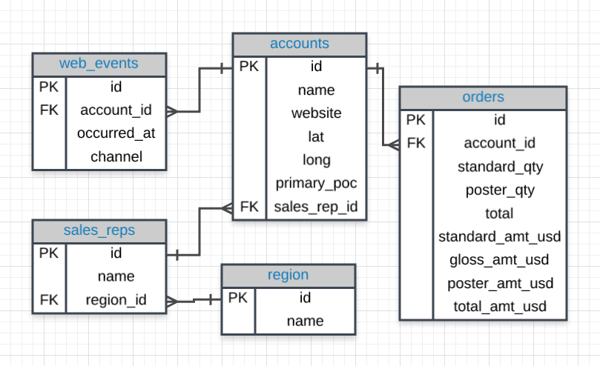
Parch and Posey ERD

Slide 7
SELECT Statement
The SELECT statement is used to query the database and retrieve selected data that match the criteria that you specify
The SELECT statement has five main clauses to choose from, although, FROM is the only required clause. Each of the clauses have a vast selection of options, parameters, etc. The clauses will be listed below, but each of them will be covered in more detail later in the tutorial.
SELECT [ALL | DISTINCT] column1[,column2]
FROM table1[,table2]
[WHERE "conditions"]
[GROUP BY "column-list"]
[HAVING "conditions]
[ORDER BY "column-list" [ASC | DESC] ]
Optional

Slide 8

What is a Relational Database?
A relational database is a set of formally described tables from which data can be accessed or reassembled in many different ways without having to reorganize the database tables.

Slide 9
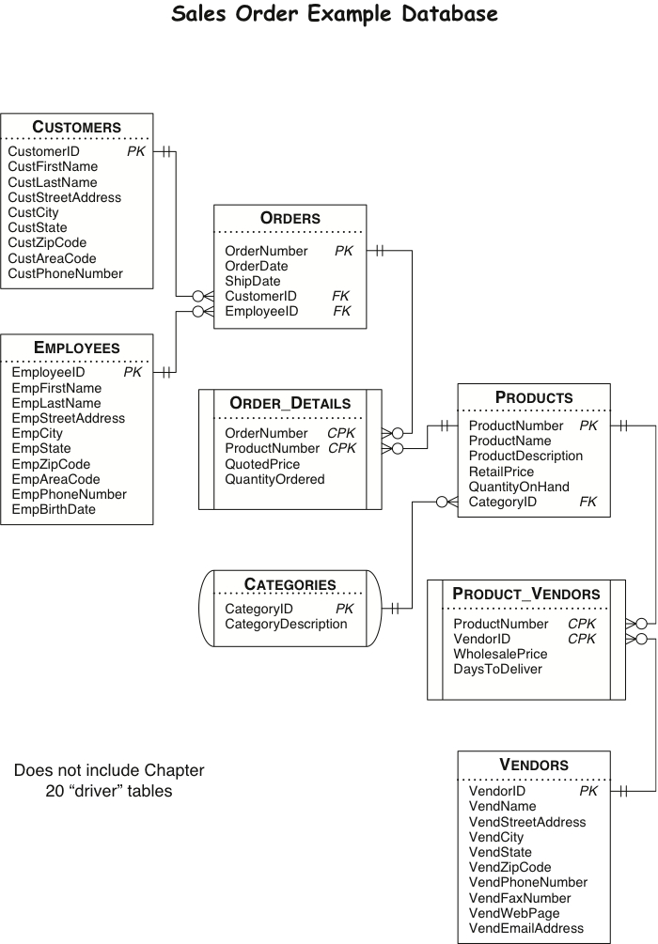
Relational Database Entity Relationship Diagrams (ERD) for Sales Data

Slide 10
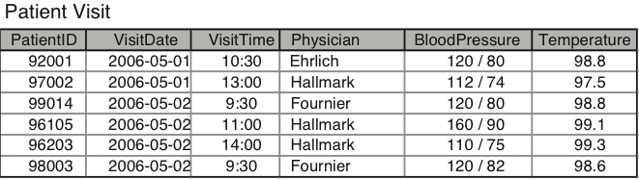
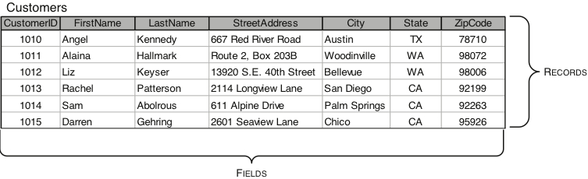
Anatomy of Relational Databases
Table:
Main structure in a database
Has at least 1 field: Primary Key
Represents:
Object: Customers
Event: Orders or Patient Visits
Fields:
Columns (Vertical) that represent characteristics of the object or event
Records:
Rows (Horizontal) that represent a unique instance of a table

Slide 11
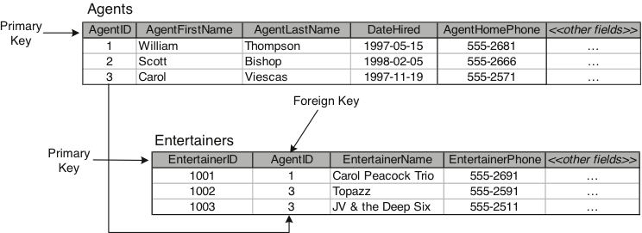
Anatomy of Relational Databases (2)
Keys:
Special fields within a table
Primary Keys (PK): Unique identifier for a record in the table e.g. USC ID, Social Security Number, etc.
Foreign Keys (FK): Helps establish relationships between tables; it is usually a primary key in a different table

Slide 12
Primary Keys and Foreign Keys

Slide 13
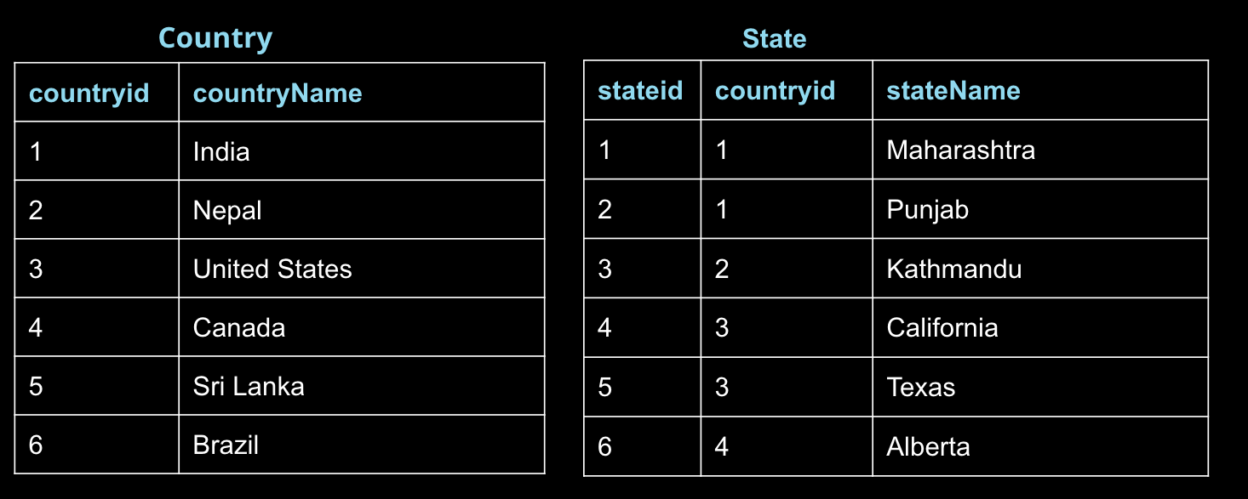
What’s the PK of the Country table?
Answer:
Country.countryid

Slide 14
What’s the PK of the State table?
Answer:
state.stateid

Slide 15
What’s the FK that could be used to join both tables?
Answer:
state.countryid

Slide 16
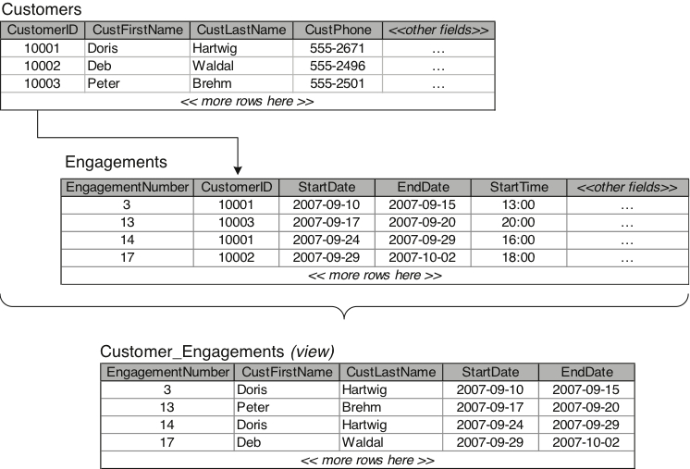
Anatomy of Relational Databases (3)
Views:
A virtual table composed of columns from one or more tables in the database.
It does not store data on its own, but it draws data from the original tables in the database
It provides flexibility for working with data

Slide 17
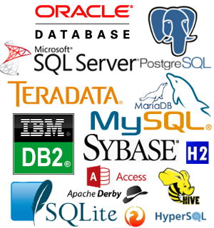
What is a DBMS and RDBMS?
DBMS:
Database Management System
RDBMS:
Relational Database Management System
A software application program you use to create, maintain, and manipulate a relational database
Models a real-world enterprise
Entities (e.g., Students, Courses)
Relationships (e.g., Alice is enrolled in 145)

Slide 18


In this class, we will use both
PostgreSQL
MySQL
All RDBMS uses SQL!

Slide 19
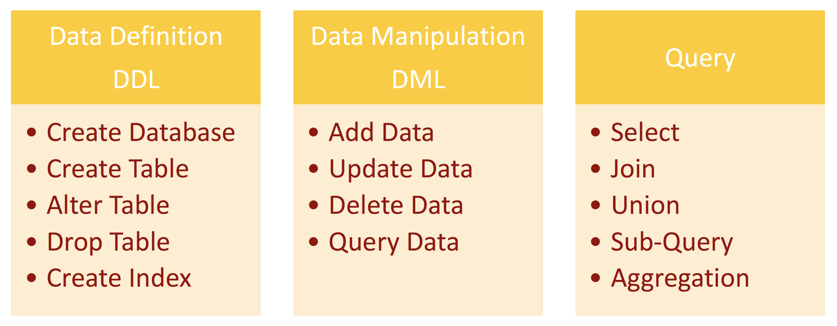
SQL Overview

Slide 20
What You Should Know
Syntax
SELECT, FROM, AS
WHERE, BETWEEN, IN, NOT
ORDER BY
LIMIT
Primary keys / foreign keys
DDL / DML
Entities and Entity Relationship Diagrams (ERDs)
Tables vs. Views

